Slide 1
Automated Scarecrow
Jacob Crabtree, Will Faulkner, Lauren Lanham, and Rianna Mueller

Slide 2
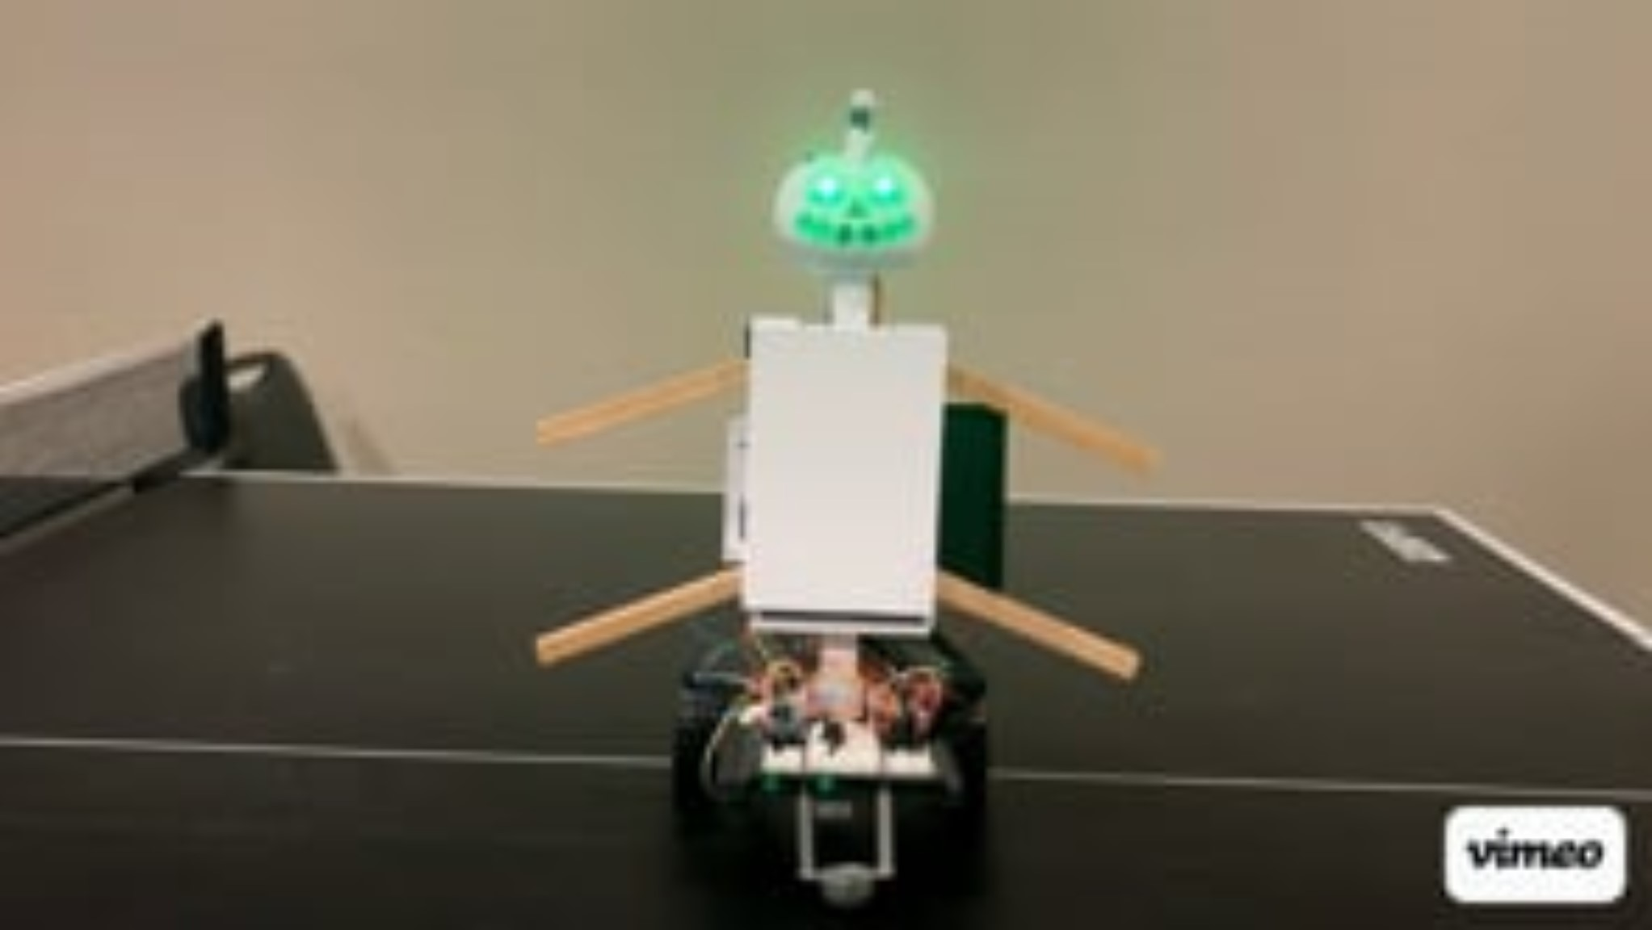

Slide 3
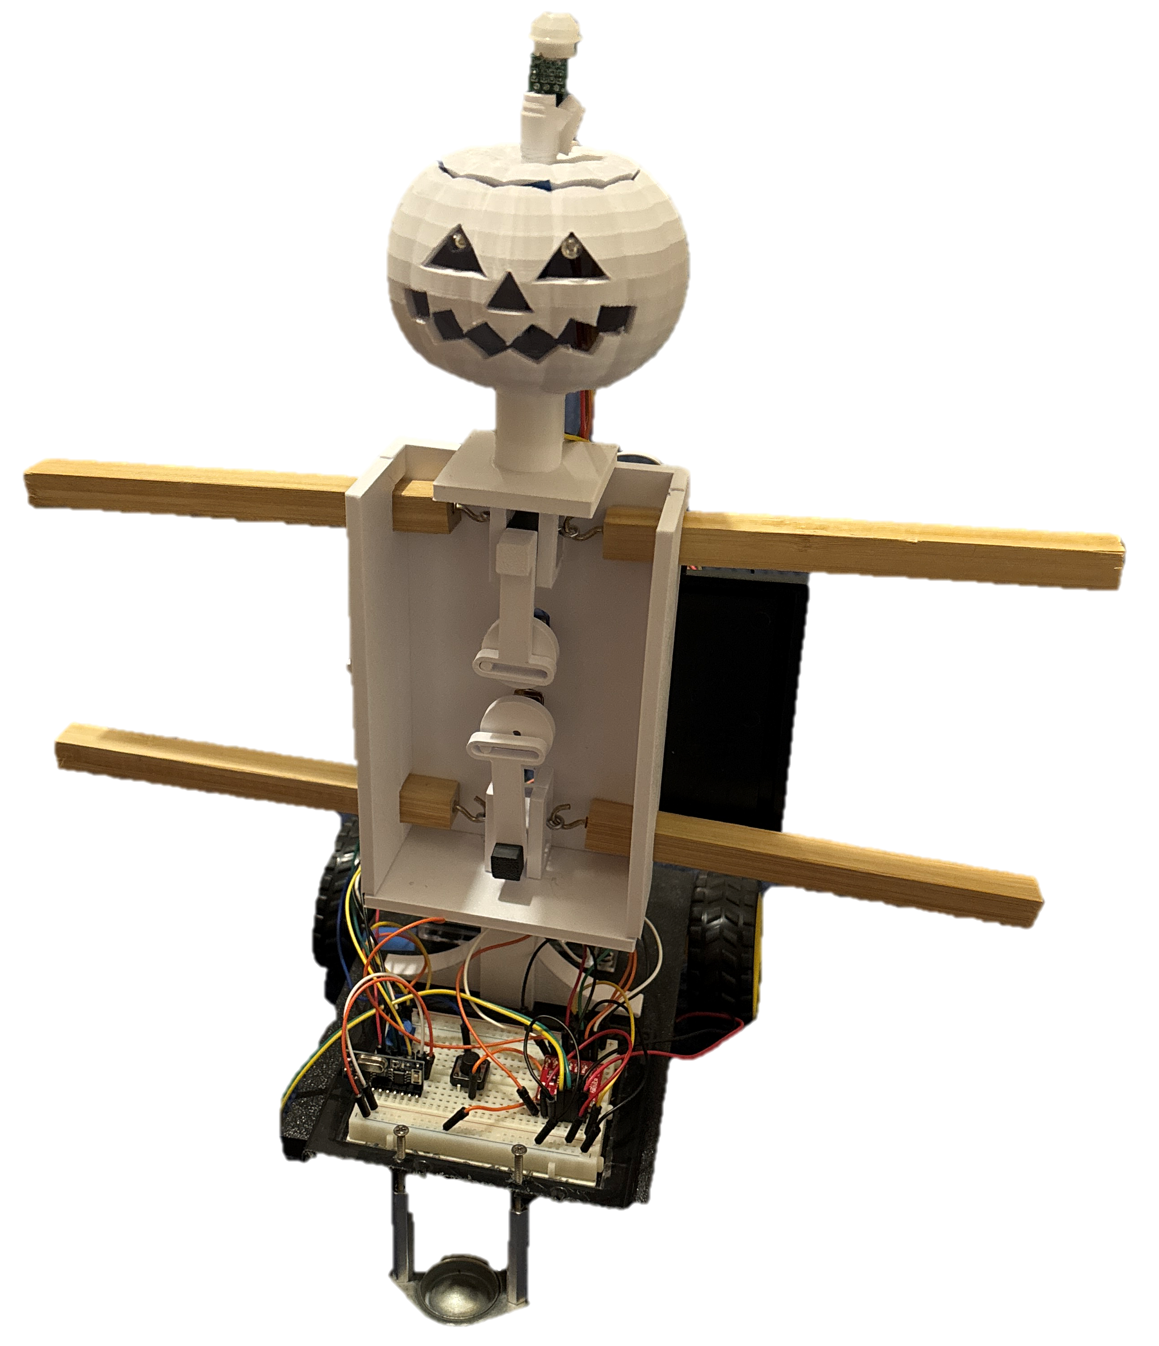
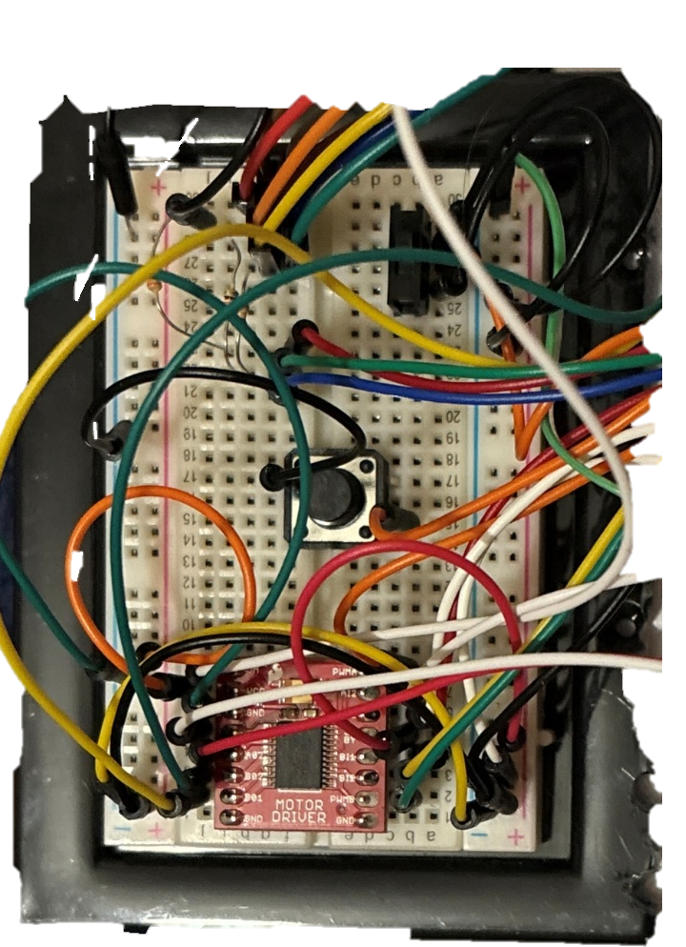
Overview
LED Lights
PIR Sensor
SPDT Switch
Arduino #2
Scotch Yoke
Arduino #2
Push Button
433 MHz Mini Receiver
Arduino #1
Flange Mounted Ball Transfer

Slide 4
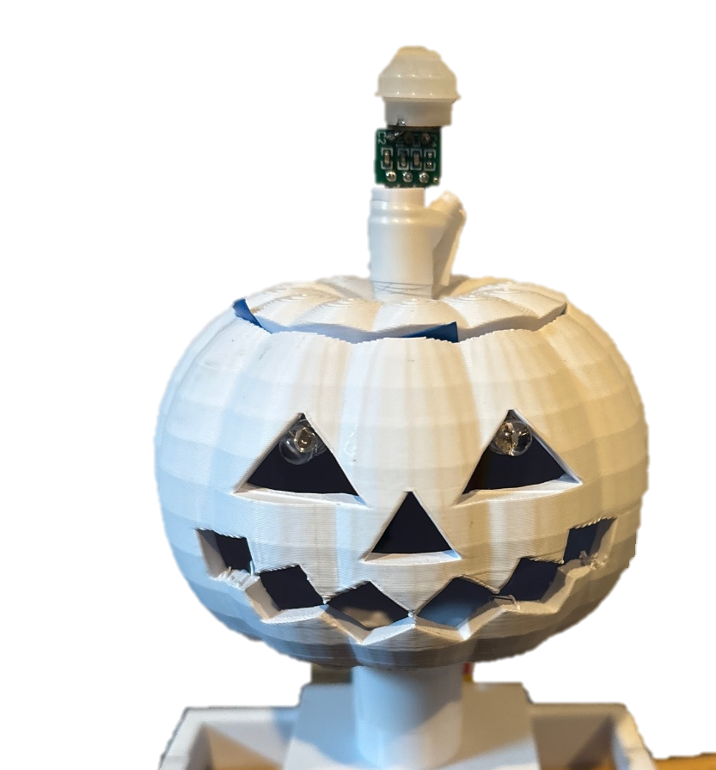
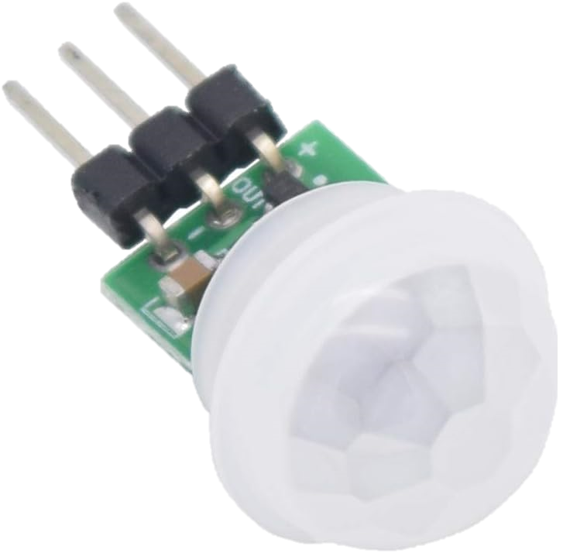
Motion Detection
Goal:
Find a sensor that will detect motion from pests (Birds, Rabbits, Deer, etc.)
Movement of the crops cannot set off the sensor
Outcomes:
PIR Sensors detect thermal movements
Triggers the LED lights to turn red and activates DC Motors for the Scotch Yoke

Slide 5
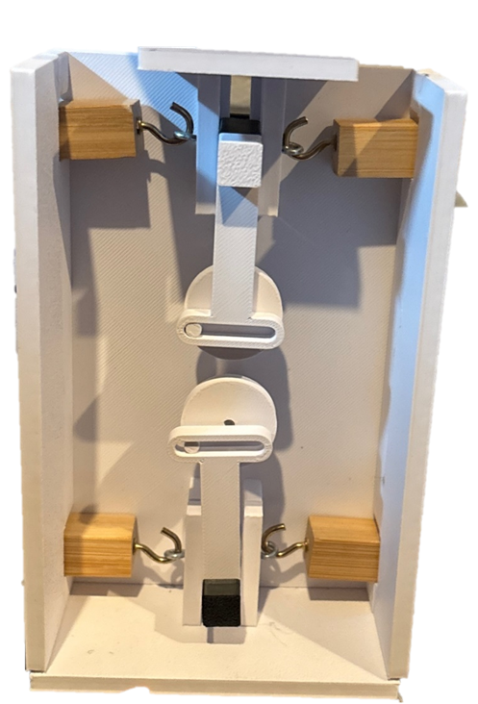
Animal deterrence
Outcomes:
A Scotch Yoke Mechanism
Goals:
Rapid Movement that will scare Pests away
All arms and legs need to move

Slide 6
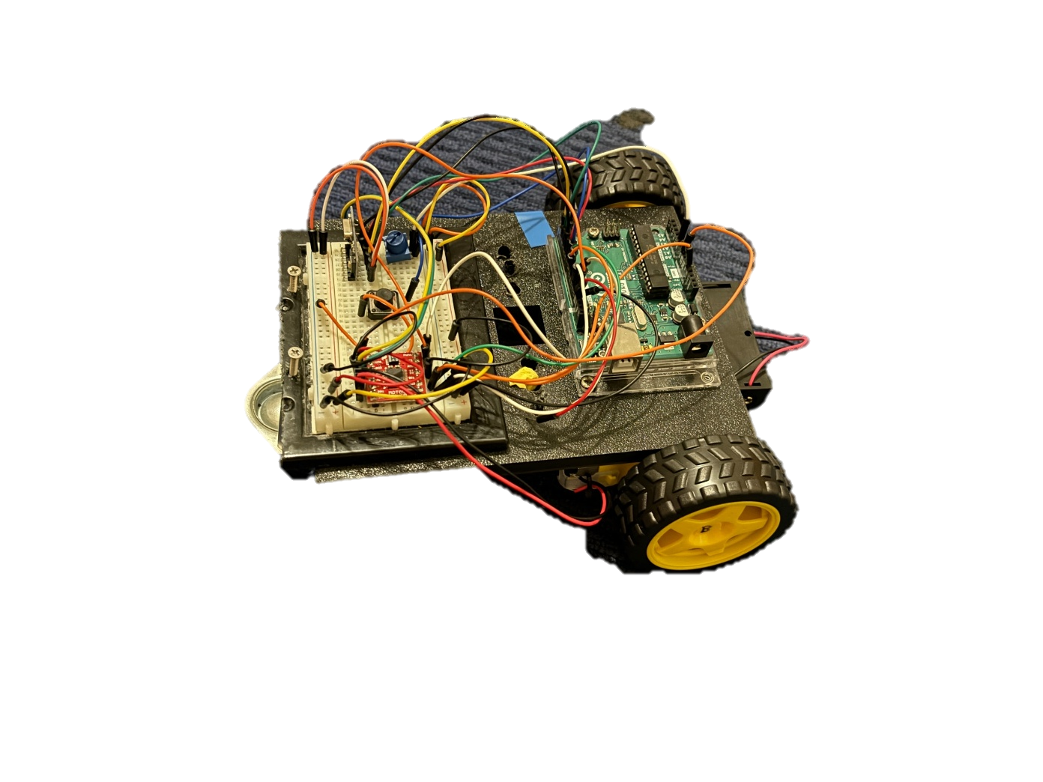
Remote Controlled Base
Outcomes:
Rear wheel Steering
Flange Mounted Ball Transfer as third wheel
Handheld transmitter
Goals:
Moves remotely around the field
Farmer can be at least 500 Ft away from Scarecrow to move it

Slide 7
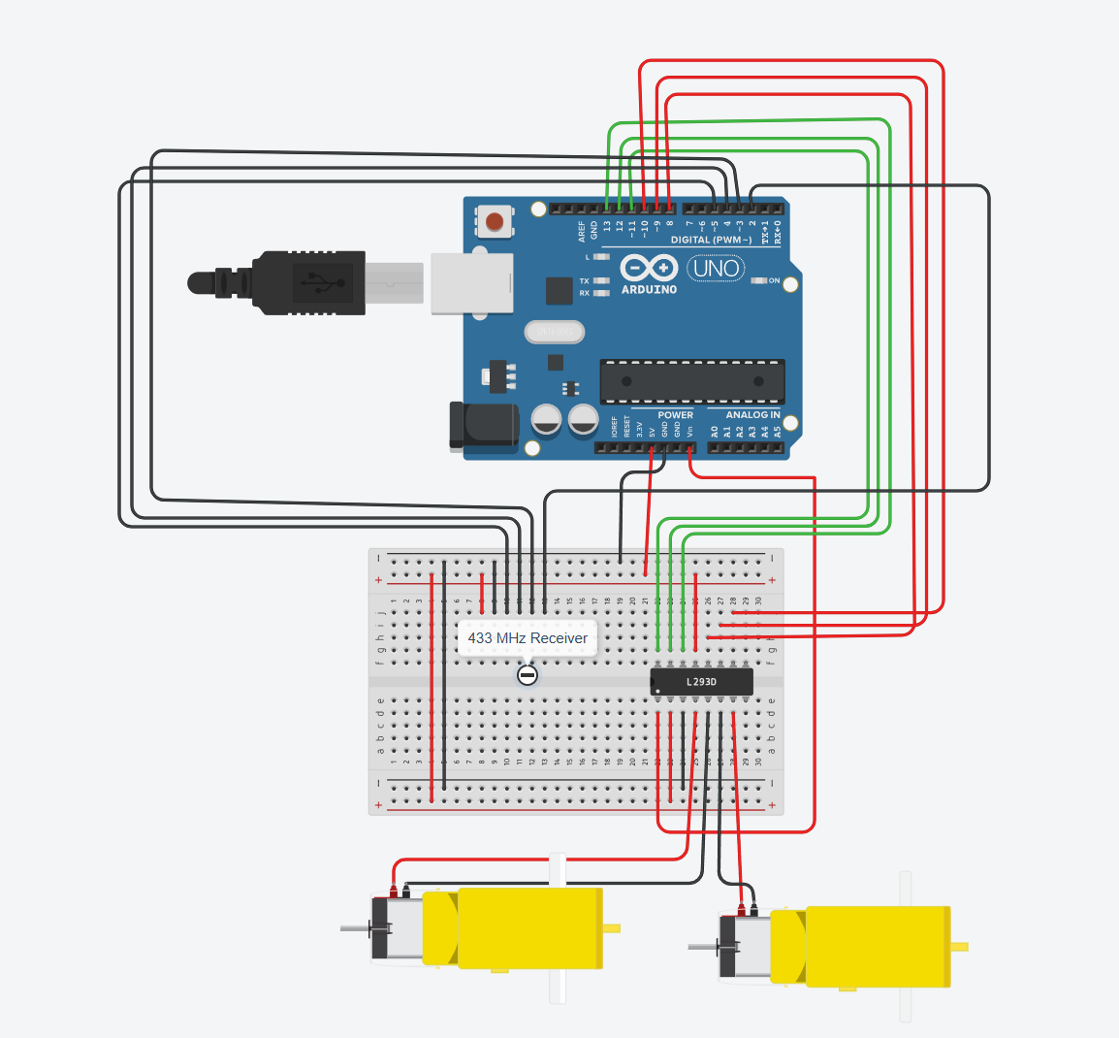
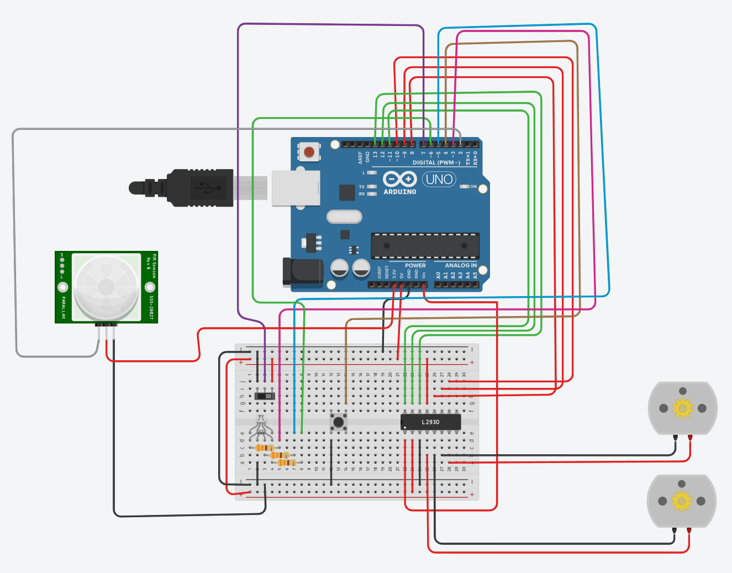
Wiring
RC Base Wiring
Body Wiring

Slide 8
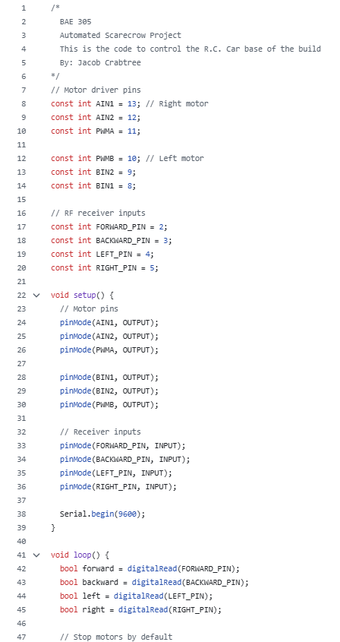
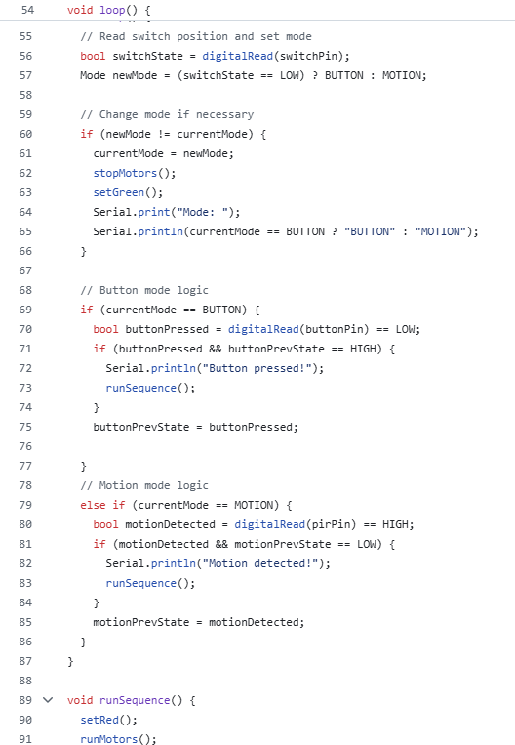
Coding
Two codes created using Arduino IDE
One code to control the RC car functions and read inputs from the RC Controller
Another code to control the motion sensing, lights, and arm and legs movements.

Slide 9
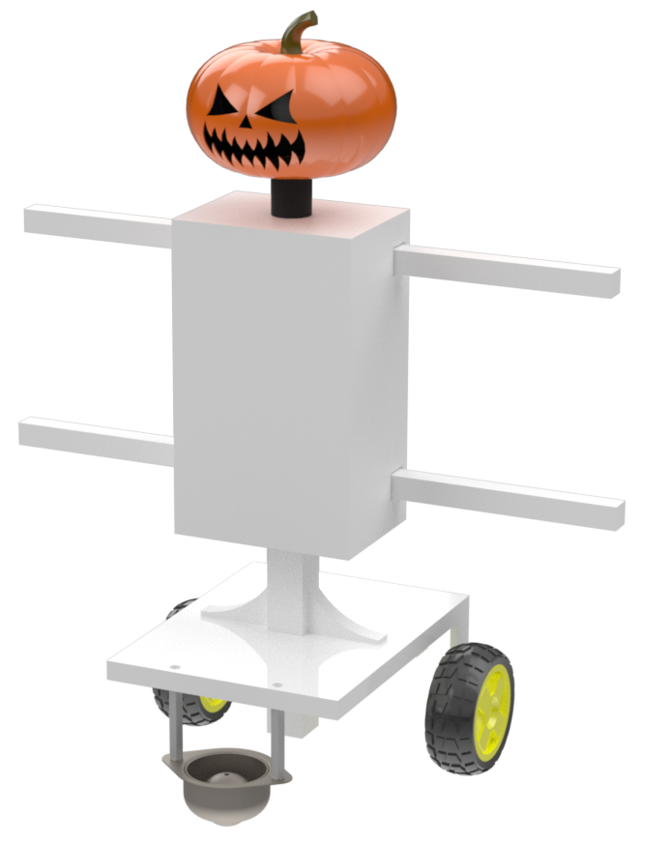
Final Conclusions
Project Setbacks:
Steering
Battery consumption
Top Heavy
Future Changes:
Improved Steering Mechanism
Dual Axle Steering
Skid Steer Approach
Increase Power Efficiency
Weight Reduction/Balanced Weight

Slide 10
Questions?

